Slide 1
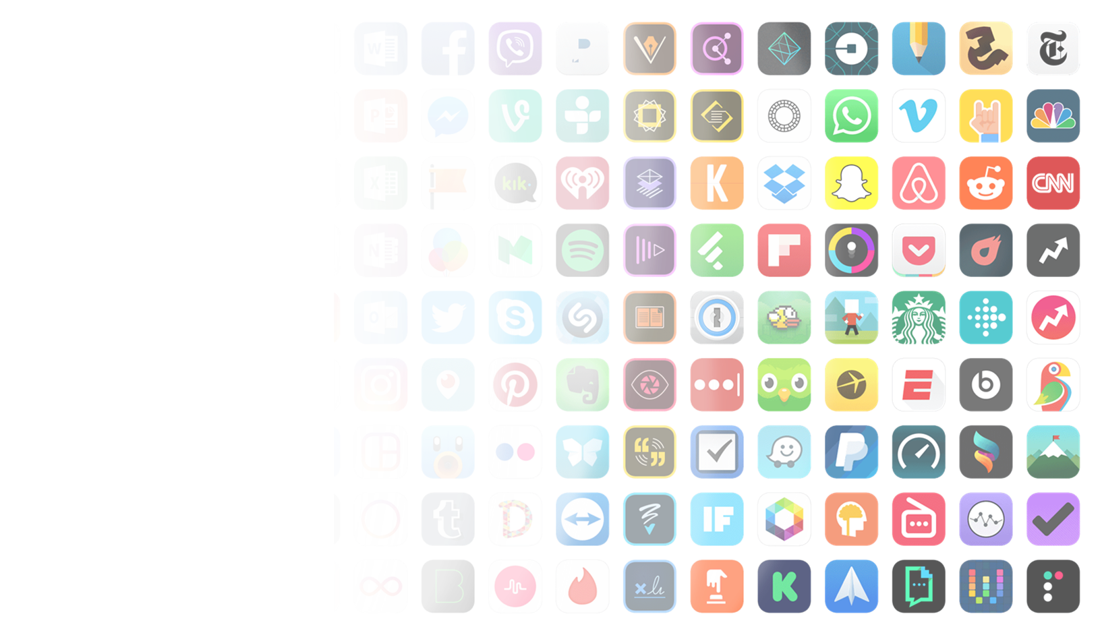
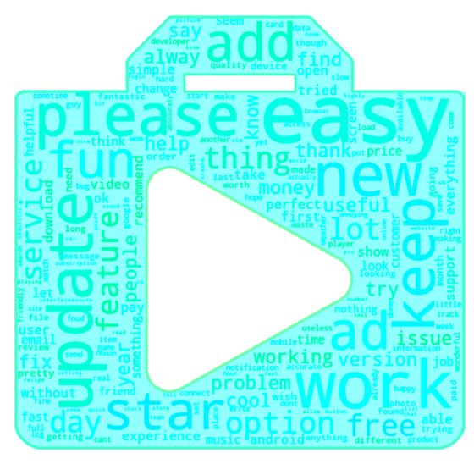
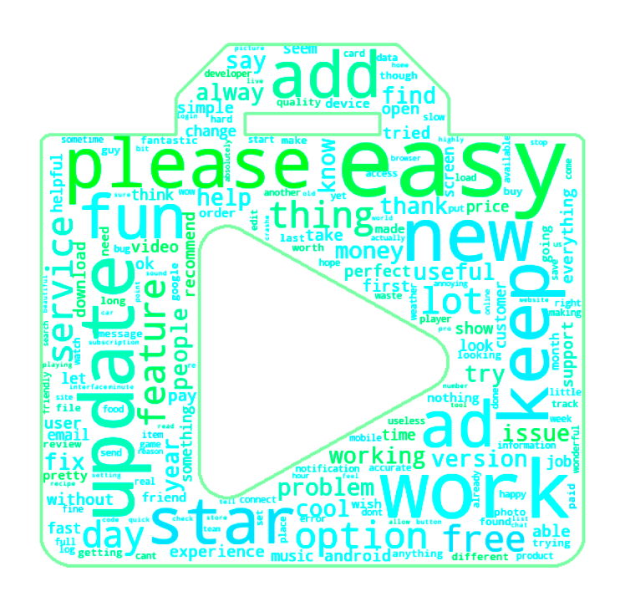
Google Play Store Complainers
Cameron Carton
demonstrator- Eoghan Cunningham
06/05/22
Notes:
This is my project Google play store review trends. It’s about analyzing sentiment and score in user reviews

Slide 2

What is the google play store?
Digital Marketplace for android apps
Users can leave a review and a rating
Notes:
So what is the google play store, it’s a digital marketplace where people publish android applications, users that download an app can then leave a review and a rating 1 – 5 stars

Slide 3
Data Collection
Collected >2 million reviews spread among 24 app genres
Google_play_scraper to collect the data
The first task was to get the digital app ids using a crawler
App ids were then input into my review scrapper
Returning the recent reviews for apps
Notes:
So for my project I collected more than 2 million reviews spread among 24 different app genres, I used a python library called google play scraper, first collecting thousands of ids for apps which I could then input into my review scrapper, to return the recent reviews for the apps.

Slide 4
Data Cleaning
The data wasn’t too dirty…
Removing columns of data I didn’t need
Removing Genres with low number of apps and reviews
Removing apps with low number of reviews
Notes:
The data wasn’t too dirty, and didn’t require that much cleaning, it was mainly just removing columns of data I didn’t need, and removing genres and apps with a low amount of reviews

Slide 5
Sentiment
Positive 1 to Negative -1, neutral 0
“This app is excellent, it’s so useful” Sentiment: 1
“This app is terrible, it’s so useless” Sentiment: -1
“This app is good, but it’s slow” Sentiment: 0.5
TextBlob for sentiment
Notes:
The main thing I analysed across all research questions was the sentiment of reviews. The sentiment score lying between -1 and positive 1. Reviews with a positive sentiment being greater than 0, and reviews with a negative sentiment being less than 0. The sentiment score was calculated using a python library called textblob

Slide 6
RQ1: Which Genre has the most Negative Marketplace?
Notes:
This brings us into the first research question, which genre has the most negative marketplace

Slide 7
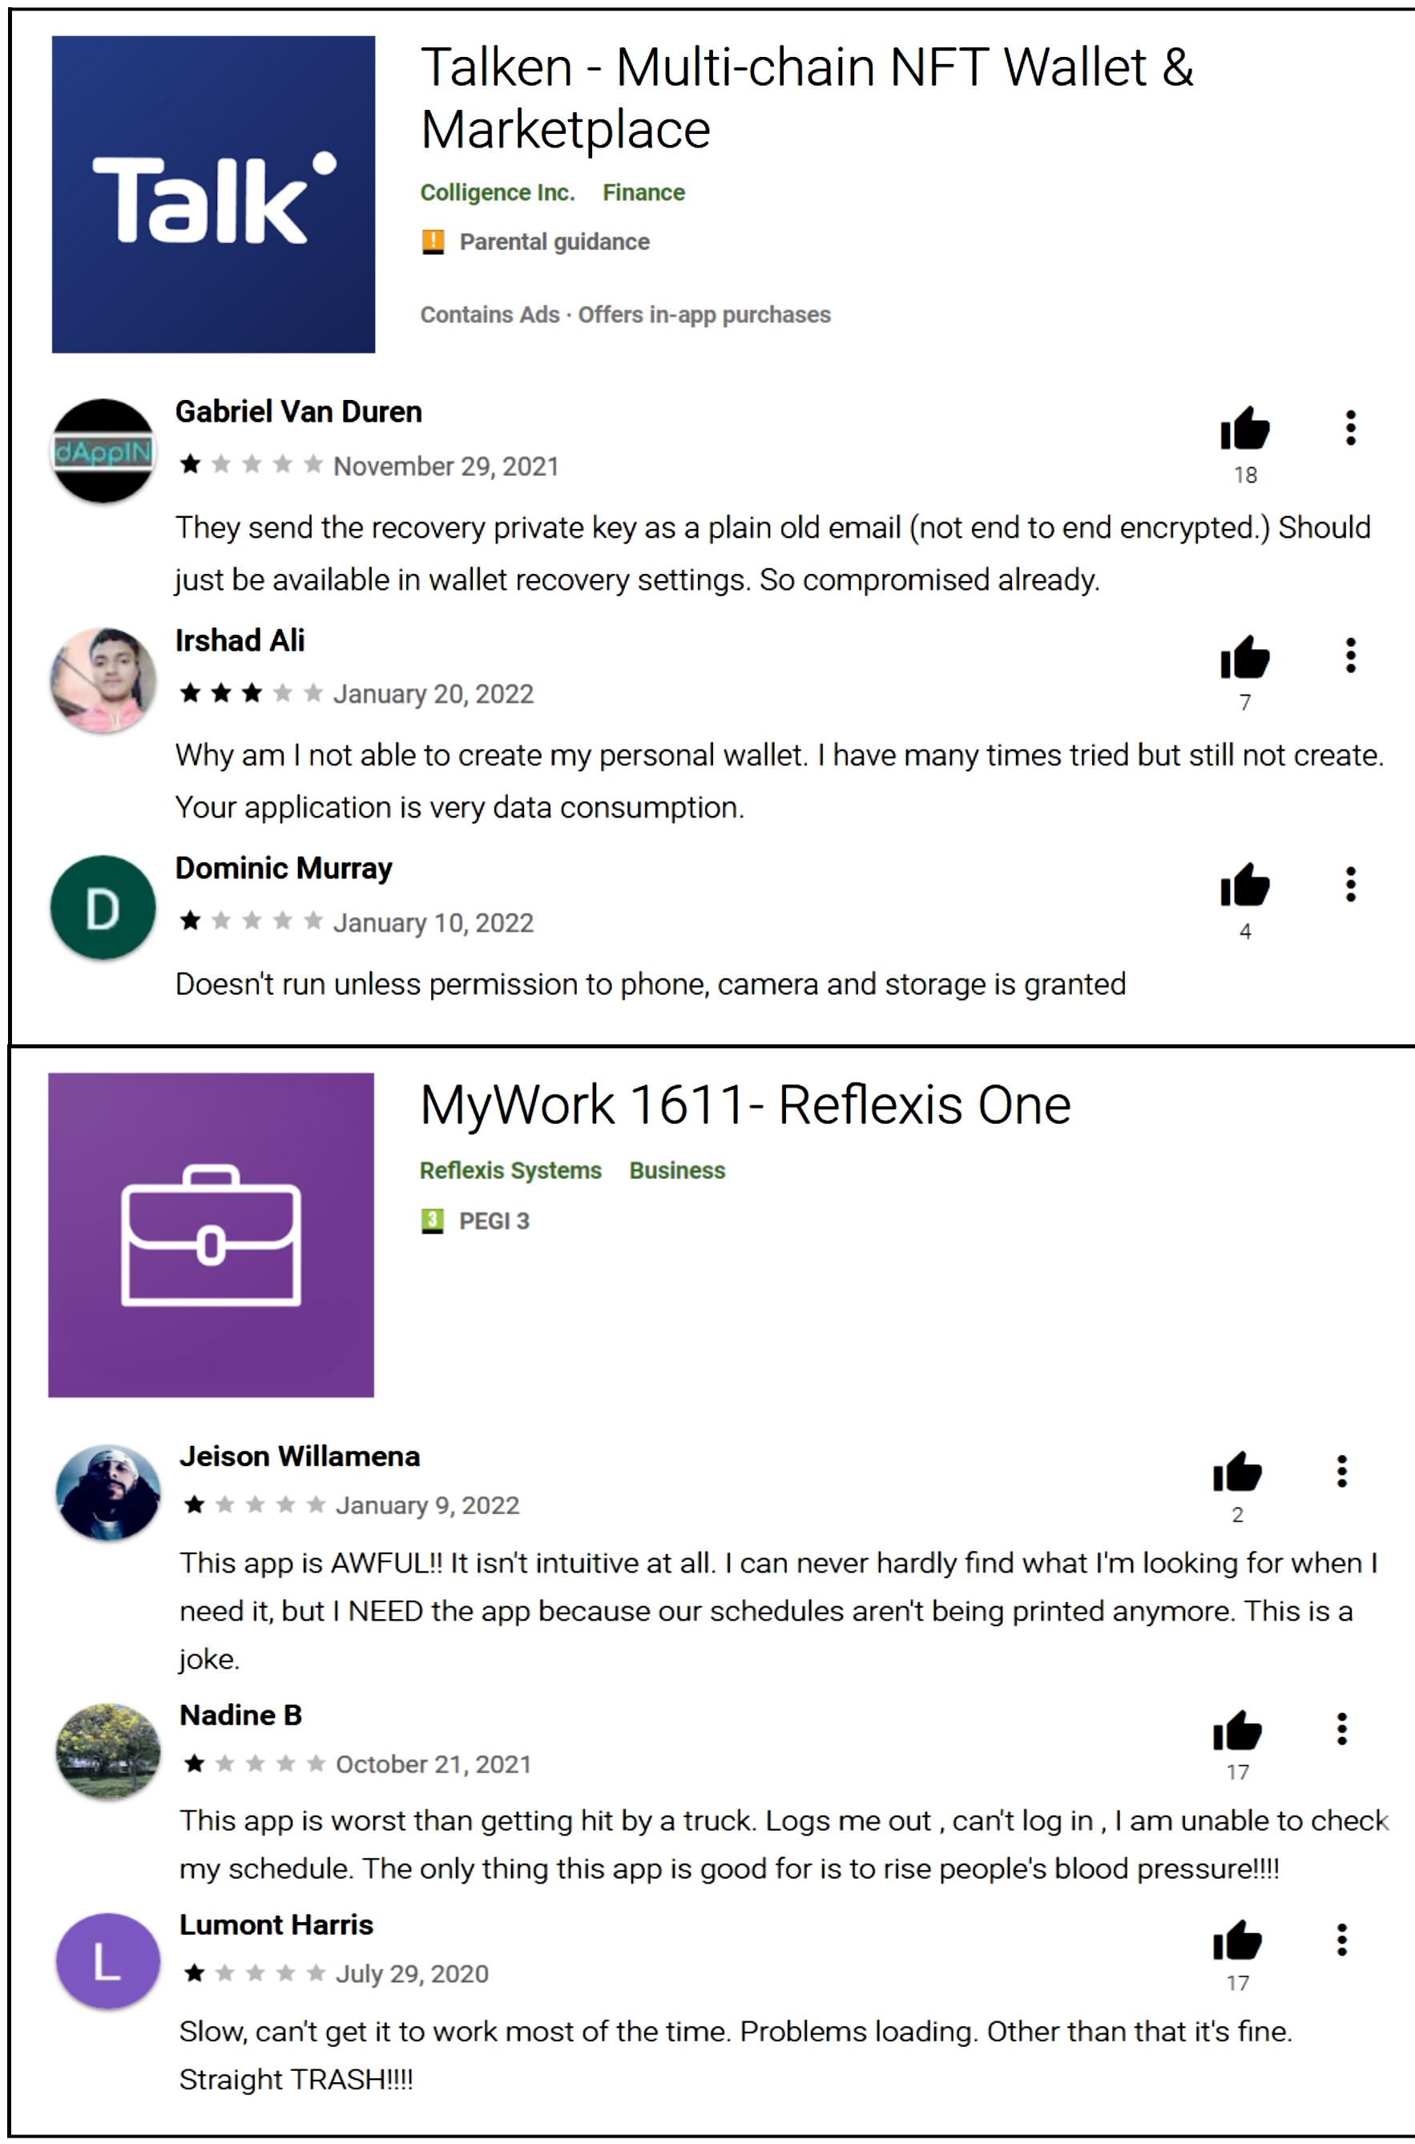
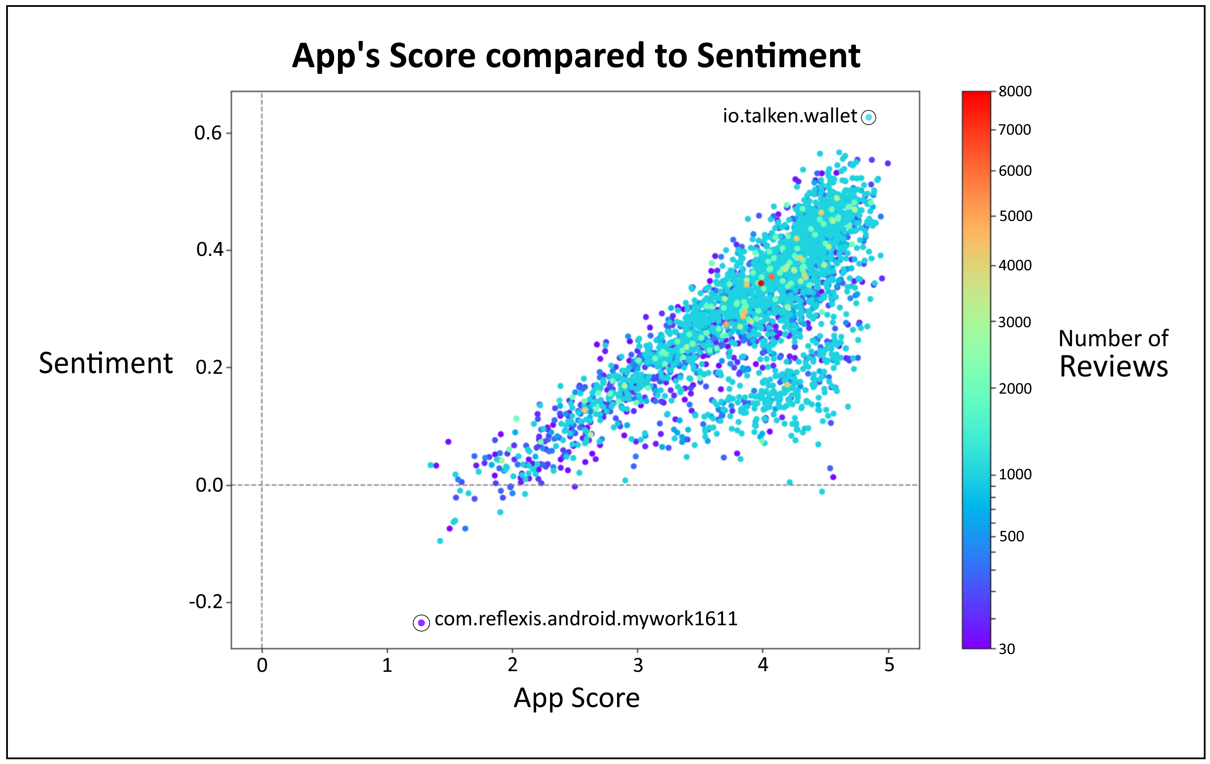
Notes:
So this is the distribution of apps with their mean app score and sentiment from their reviews. The color map relating to how many reviews in the app. Most apps having 1000 reviews.
Now I just highlighted the most positive and negative sentiment apps. The most positive being a nft crypto wallet and the negative being a business app for scheduling. And you can see the positive apps low score reviews are more constructive criticism, pointing out problems, whilst the negative app low reviews are a bit more dramatic, using more emotional language.
You can see there is a direct correlation between the score and sentiment. But there seems to be a group that deviates from the rest, which as it turns out is the games genre. So although it doesn't have necessarily high app scores, it has low sentiment relative to other genre.

Slide 8
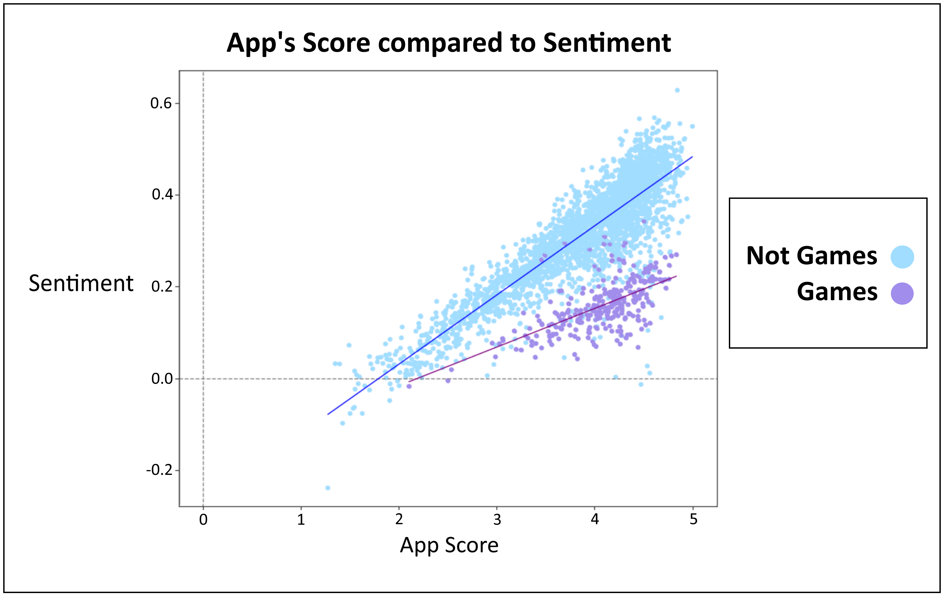
Notes:
You can see there is a direct correlation between the score and sentiment. But there seems to be a group that deviates from the rest, which as it turns out is the games genre. So although it doesn't have necessarily low app scores, it has low sentiment relative to other genre.

Slide 9
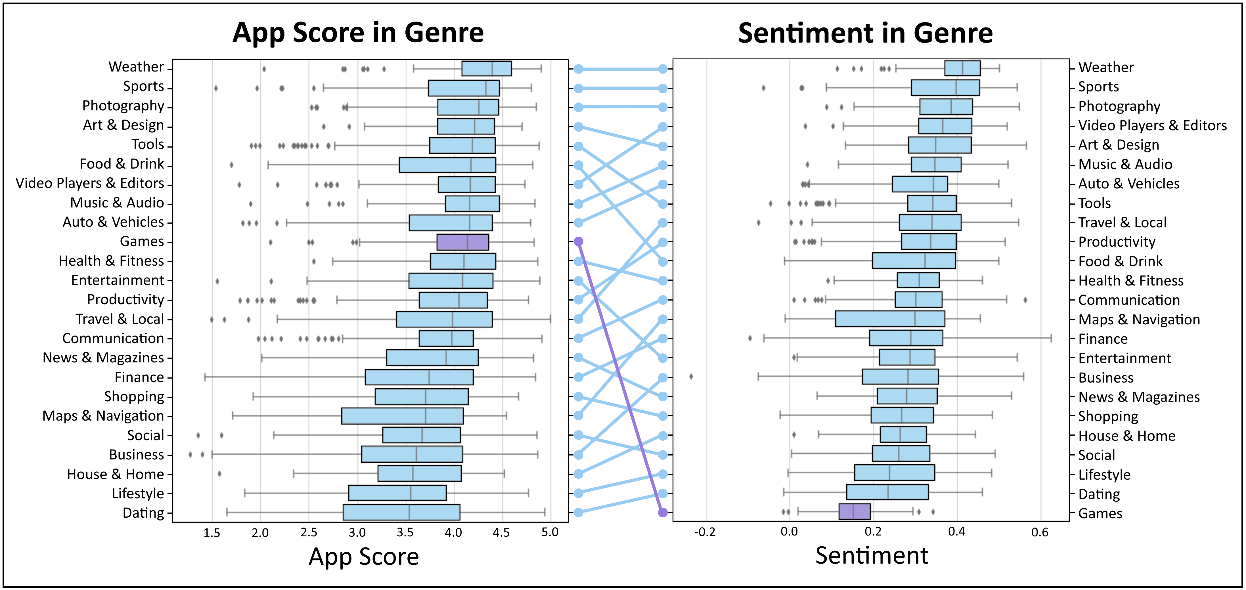
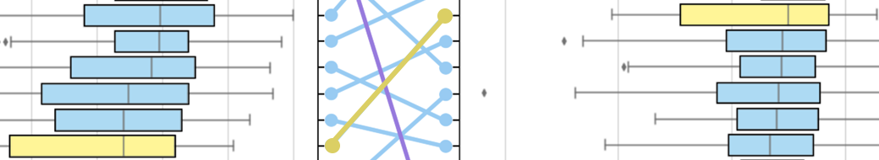
Notes:
We can get a better look at this here, and see the rankings of genre relative to their median values in both app score and sentiment. So games in particular having a huge drop in sentiment relative to its score.
Which is different than something like dating which has both low score and sentiment.
And on the other end of it, we have maps & navigation which has significantly higher sentiment relative to its score.

Slide 10
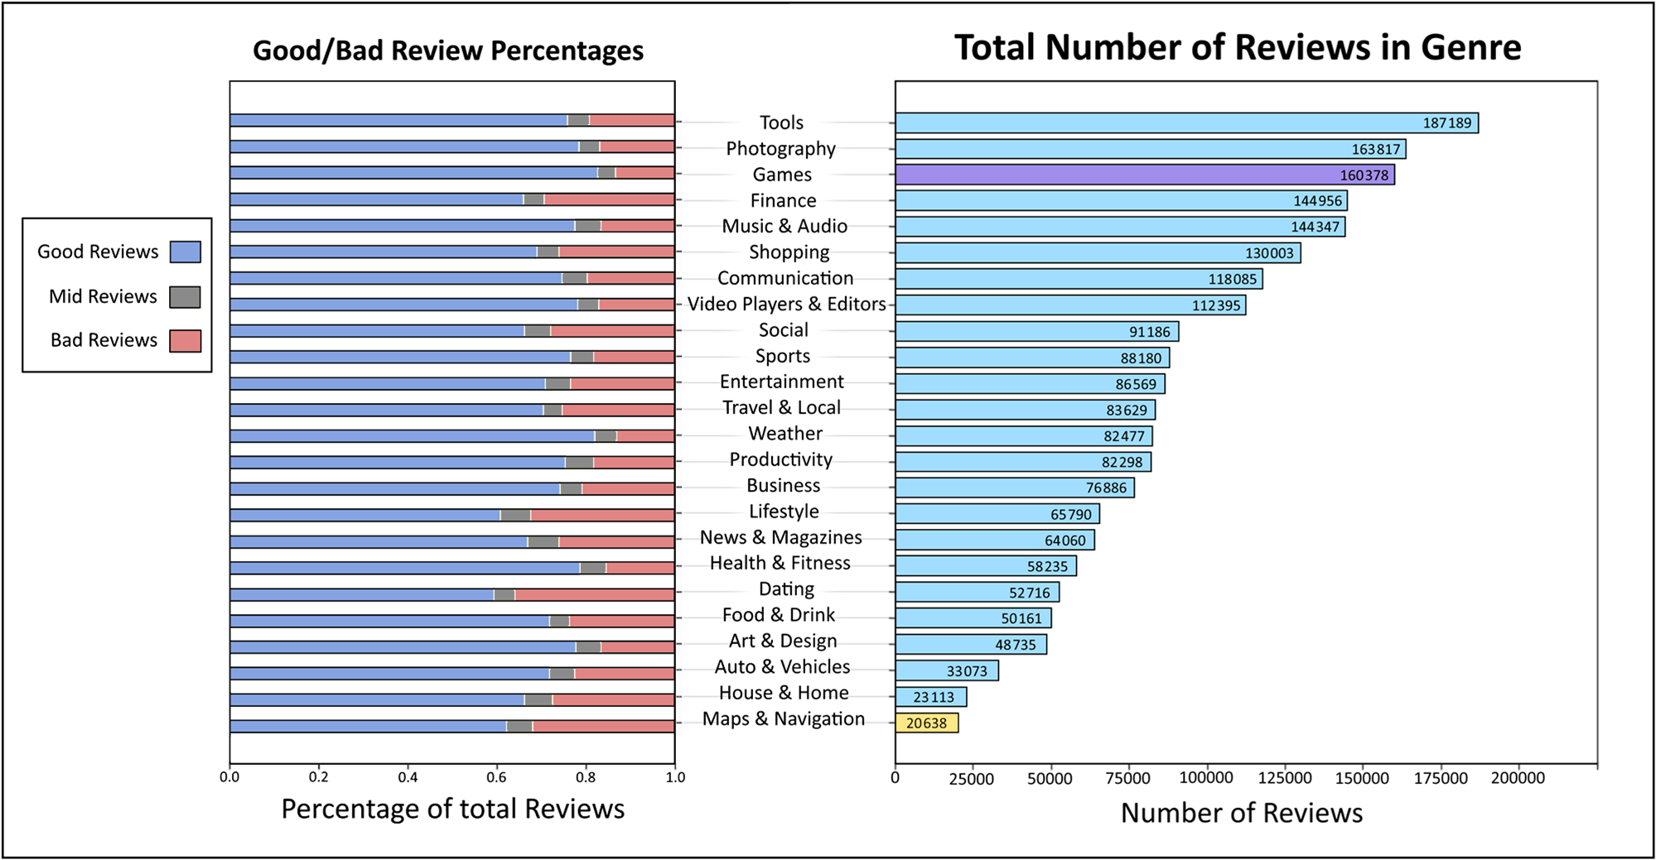
Notes:
Here we have how many reviews in each genre and their percentages of good and bad reviews. A good review being a 4 or 5 star review, and a bad review being a 1 or 2 star review.

Slide 11
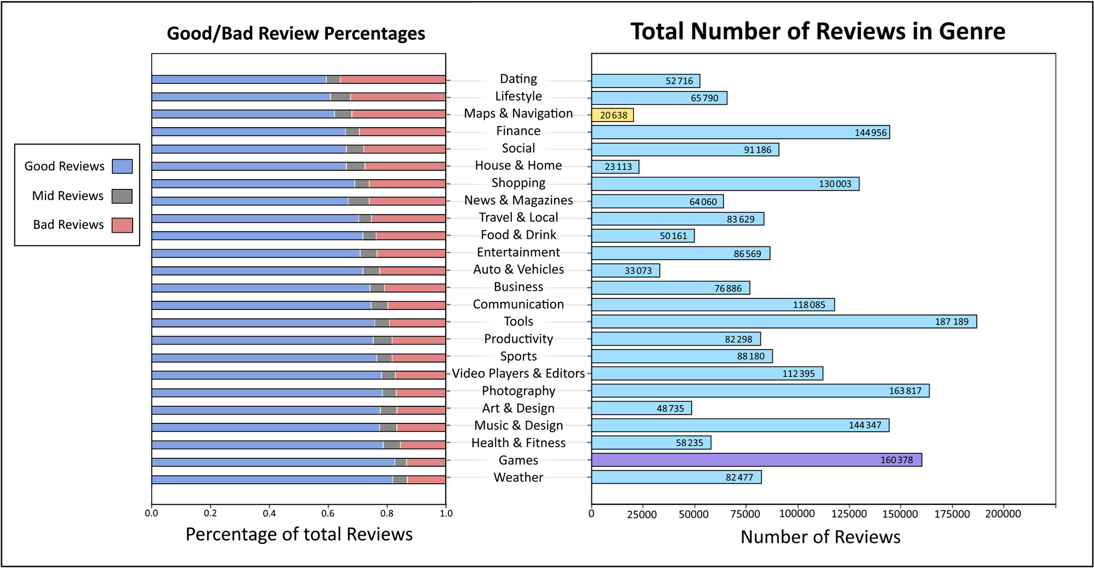
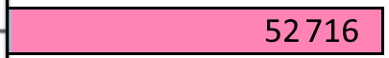
Notes:
So we can see games actually has the second least amount of bad reviews. While unsurprisingly dating has the highest percentage of bad reviews.

Slide 12
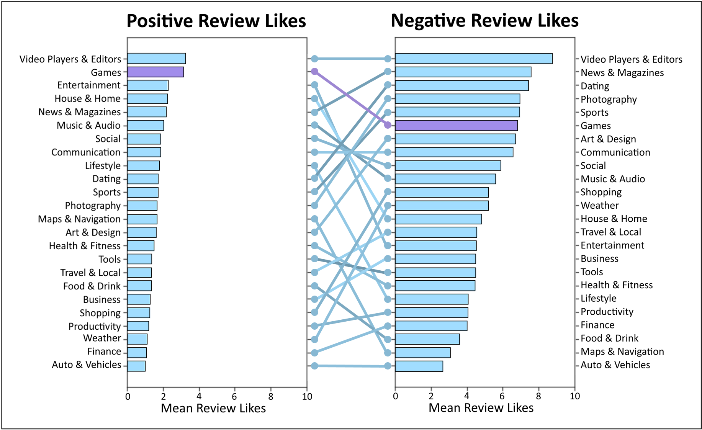
Notes:
Users are able to like and upvote reviews they found helpful. So Here we have the average likes for positive reviews and negative reviews in each genre.
These results are actually calculated genre specific, so a positive review for a genre, is a review with sentiment greater than the median sentiment for the genre, and a negative review would be reviews with sentiment lower than the genres median. One thing you'll notice, negative reviews get more likes and more support,
These results would be influenced by things like, how much user traffic there is going into a genre, so the next graph gives a clearer picture of what's going on.

Slide 13
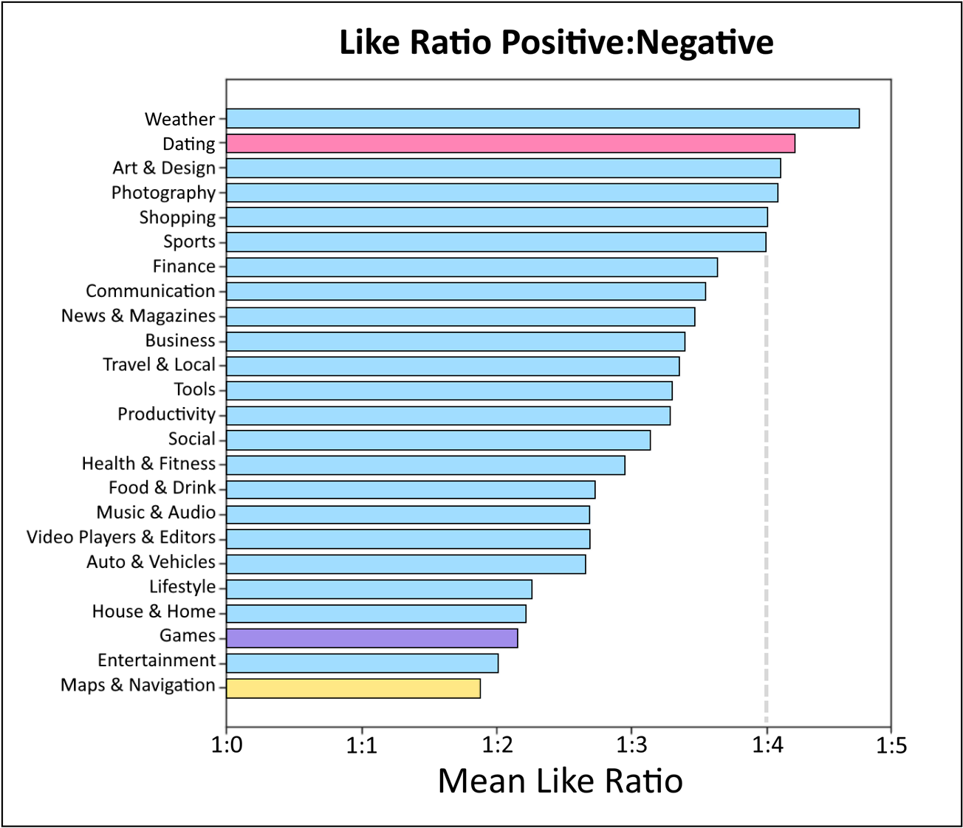
Conclusion
More Negative Genre
Dating
Games
More Positive Genre
Maps & Navigation
Notes:
The positive to negative like ratio. So now we can see games actually falls to the lower ranks of the list, whilst dating has over 4 times the amount of likes on its negative reviews than it does on its positive reviews.
So while maps & navigation is consistently a friendly genre, games seems to have high scoring apps with a reviewer base that's not very positive, and dating looks to have reviewers that are just angry because their apps are low quality.

Slide 14
RQ2: Which Reviewers are the most responsive?
Notes:
This brings us into the next research question, which reviewers are the most responsive.
So this is more so looking at the actual text of reviews.

Slide 15
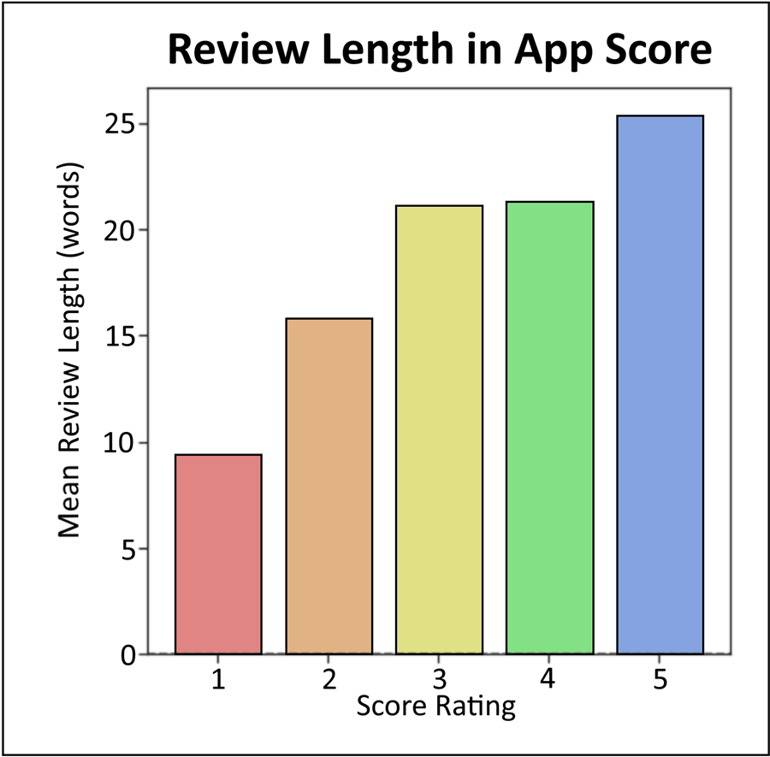
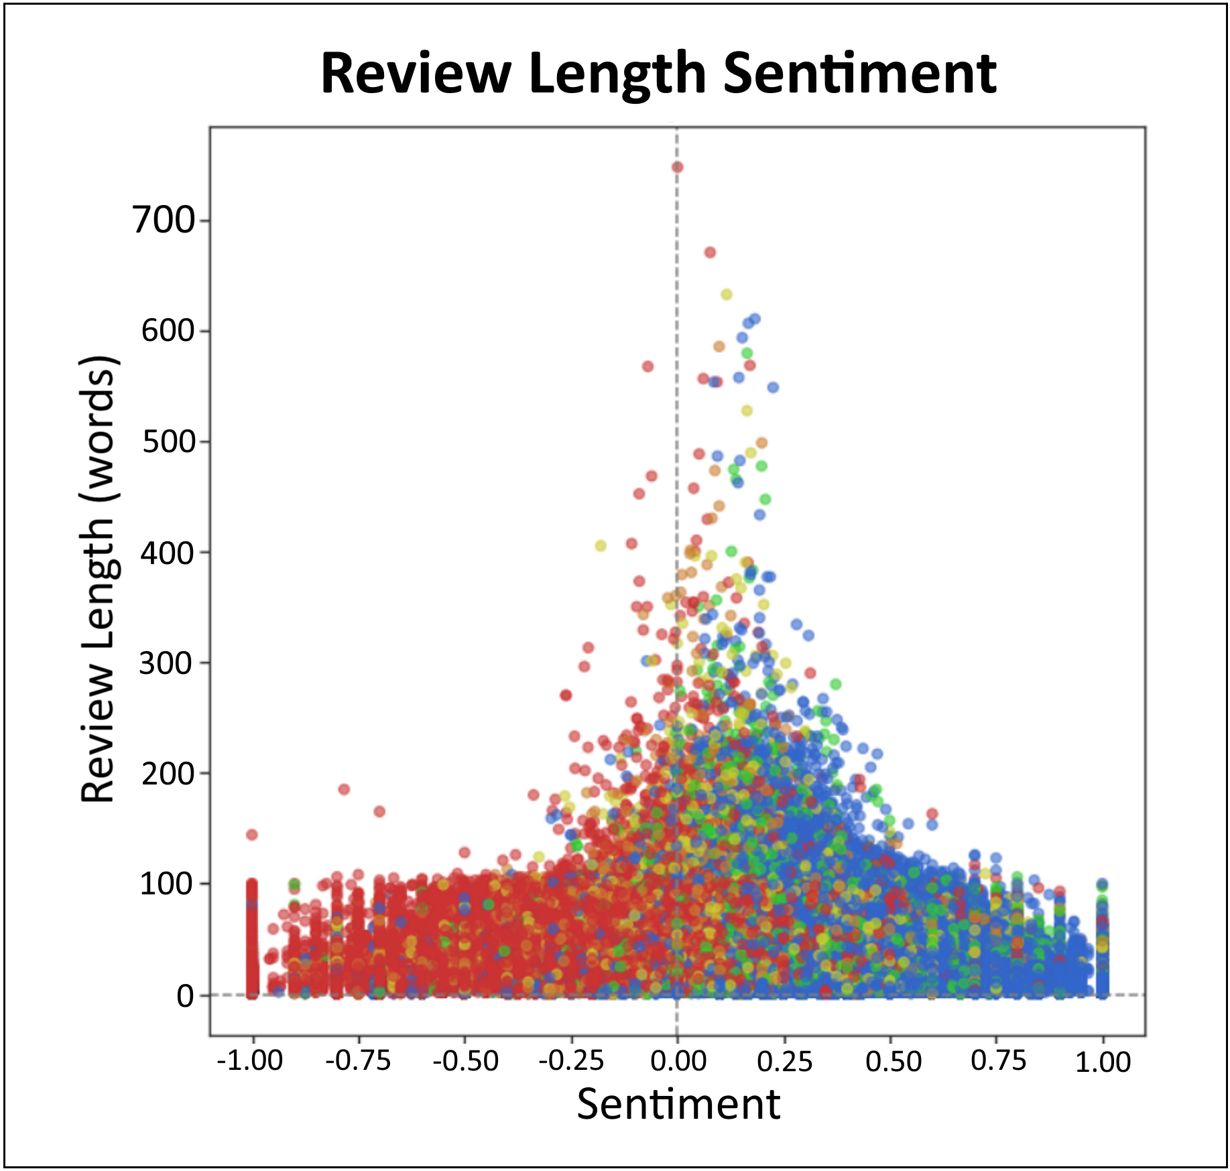
Notes:
Reviews tend to be longer the higher the rating given. Averaging about 25 words in a 5 star review, and just under 10 words in a 1 star review.
Review sentiment does not appear to have any kind of bias toward review length, and we can see most reviews don't break the 100 word mark, which is near enough the character limit for a review.

Slide 16
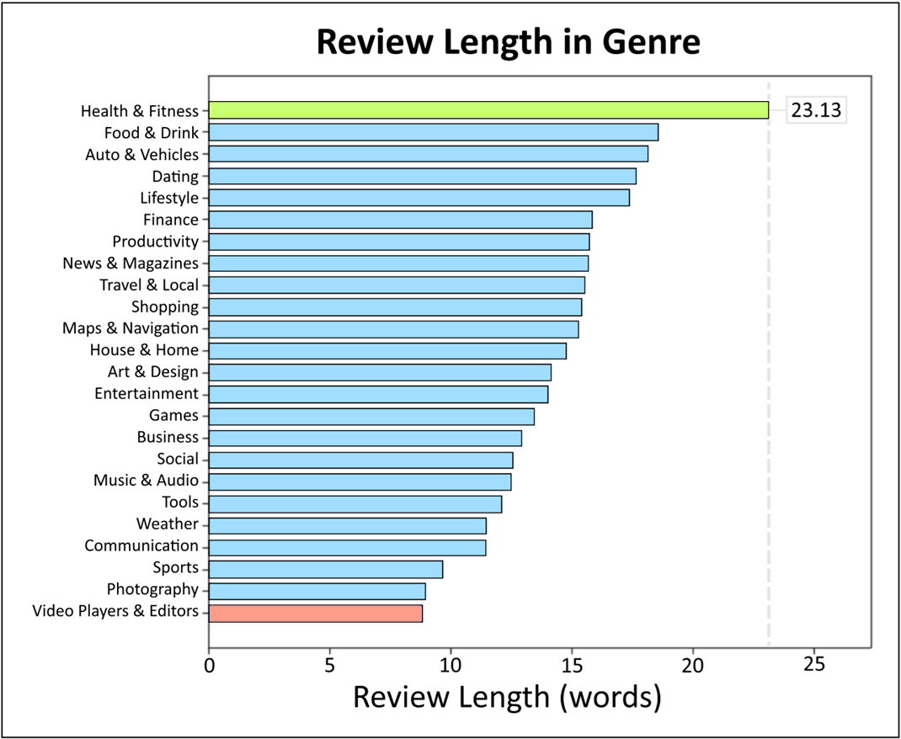
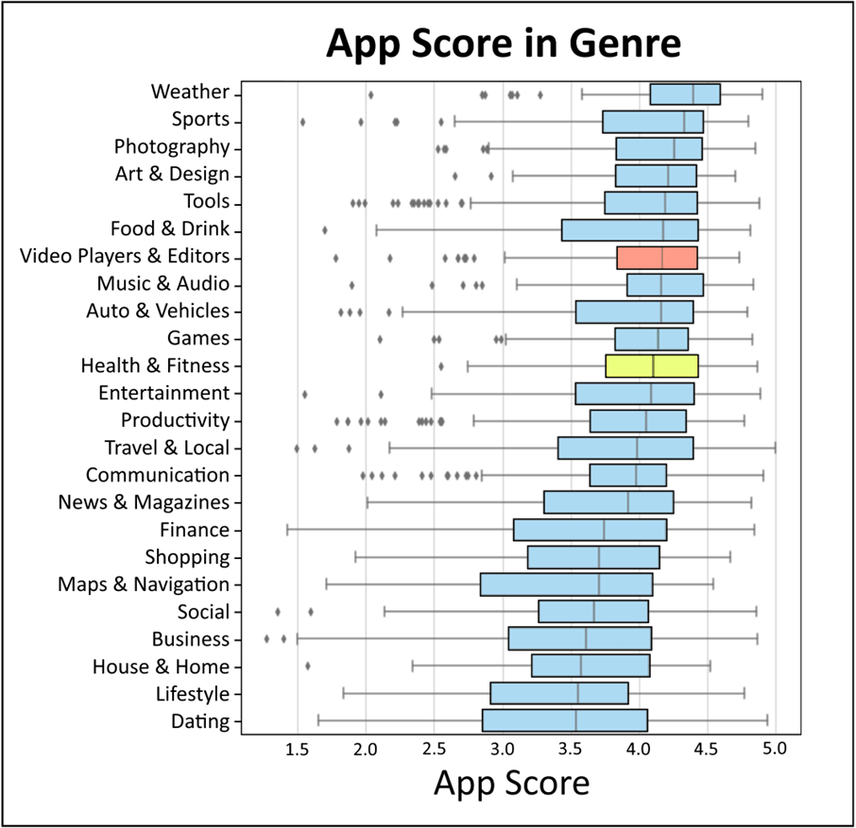
Notes:
We can see health and fitness having the highest average review length and video players having the lowest length.
Which we can see isn’t necessarily influenced by the genres score.

Slide 17
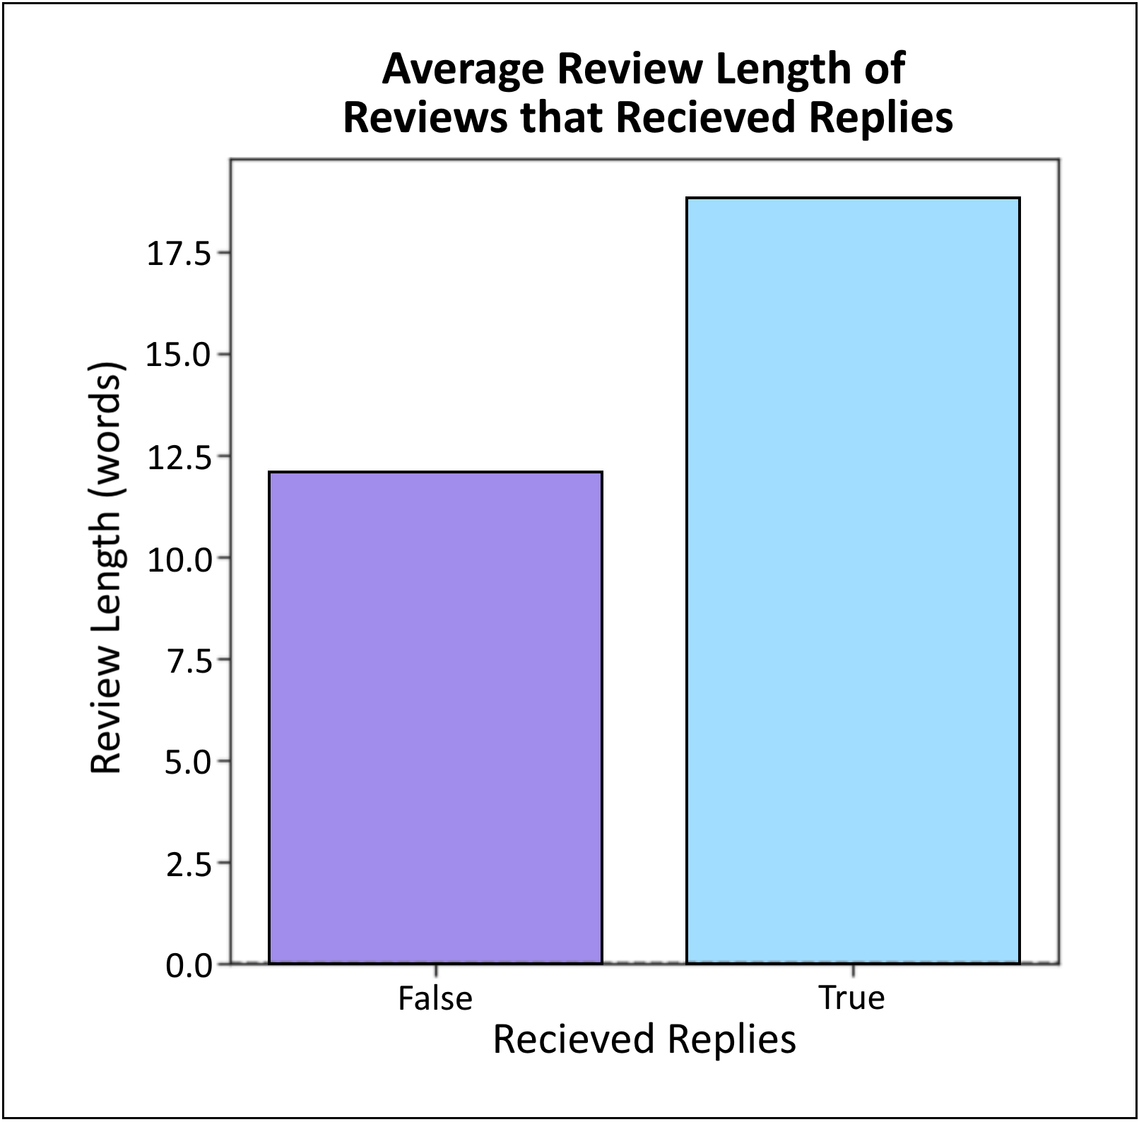
Reviews that Received Replies were longer on average
Notes:
And interestingly enough, Reviews that received replies were longer on average

Slide 18
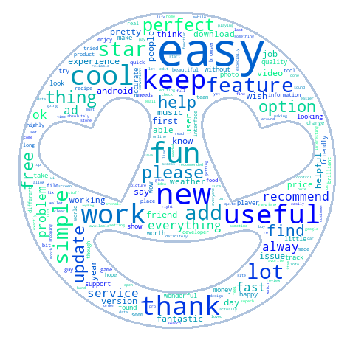
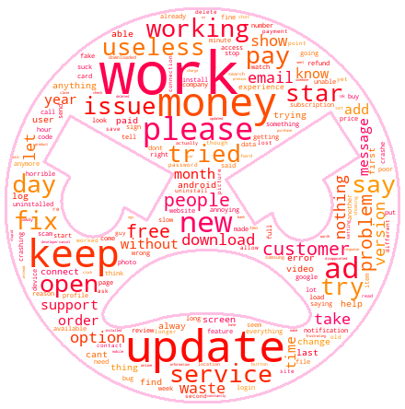
Good Review Words
Bad Review Words
Notes:
Here we can see the most common words in good and bad reviews. I did filter out most of the words relating to sentiment, like good great and, bad awful, just so that more interesting words could float to the top of the list. Looking at the good reviews, we can see things like, easy, useful, and even free,
While looking at the bad reviews we can see multiple words relating to an apps monetization, such as money, pay, ad, as well as more general things like update, and useless.

Slide 19
RQ3: Does an App’s Monetization Scheme influence Review Ratings?
Notes:
So this brings us into the last research question, does an apps monetization scheme influence review ratings.

Slide 20
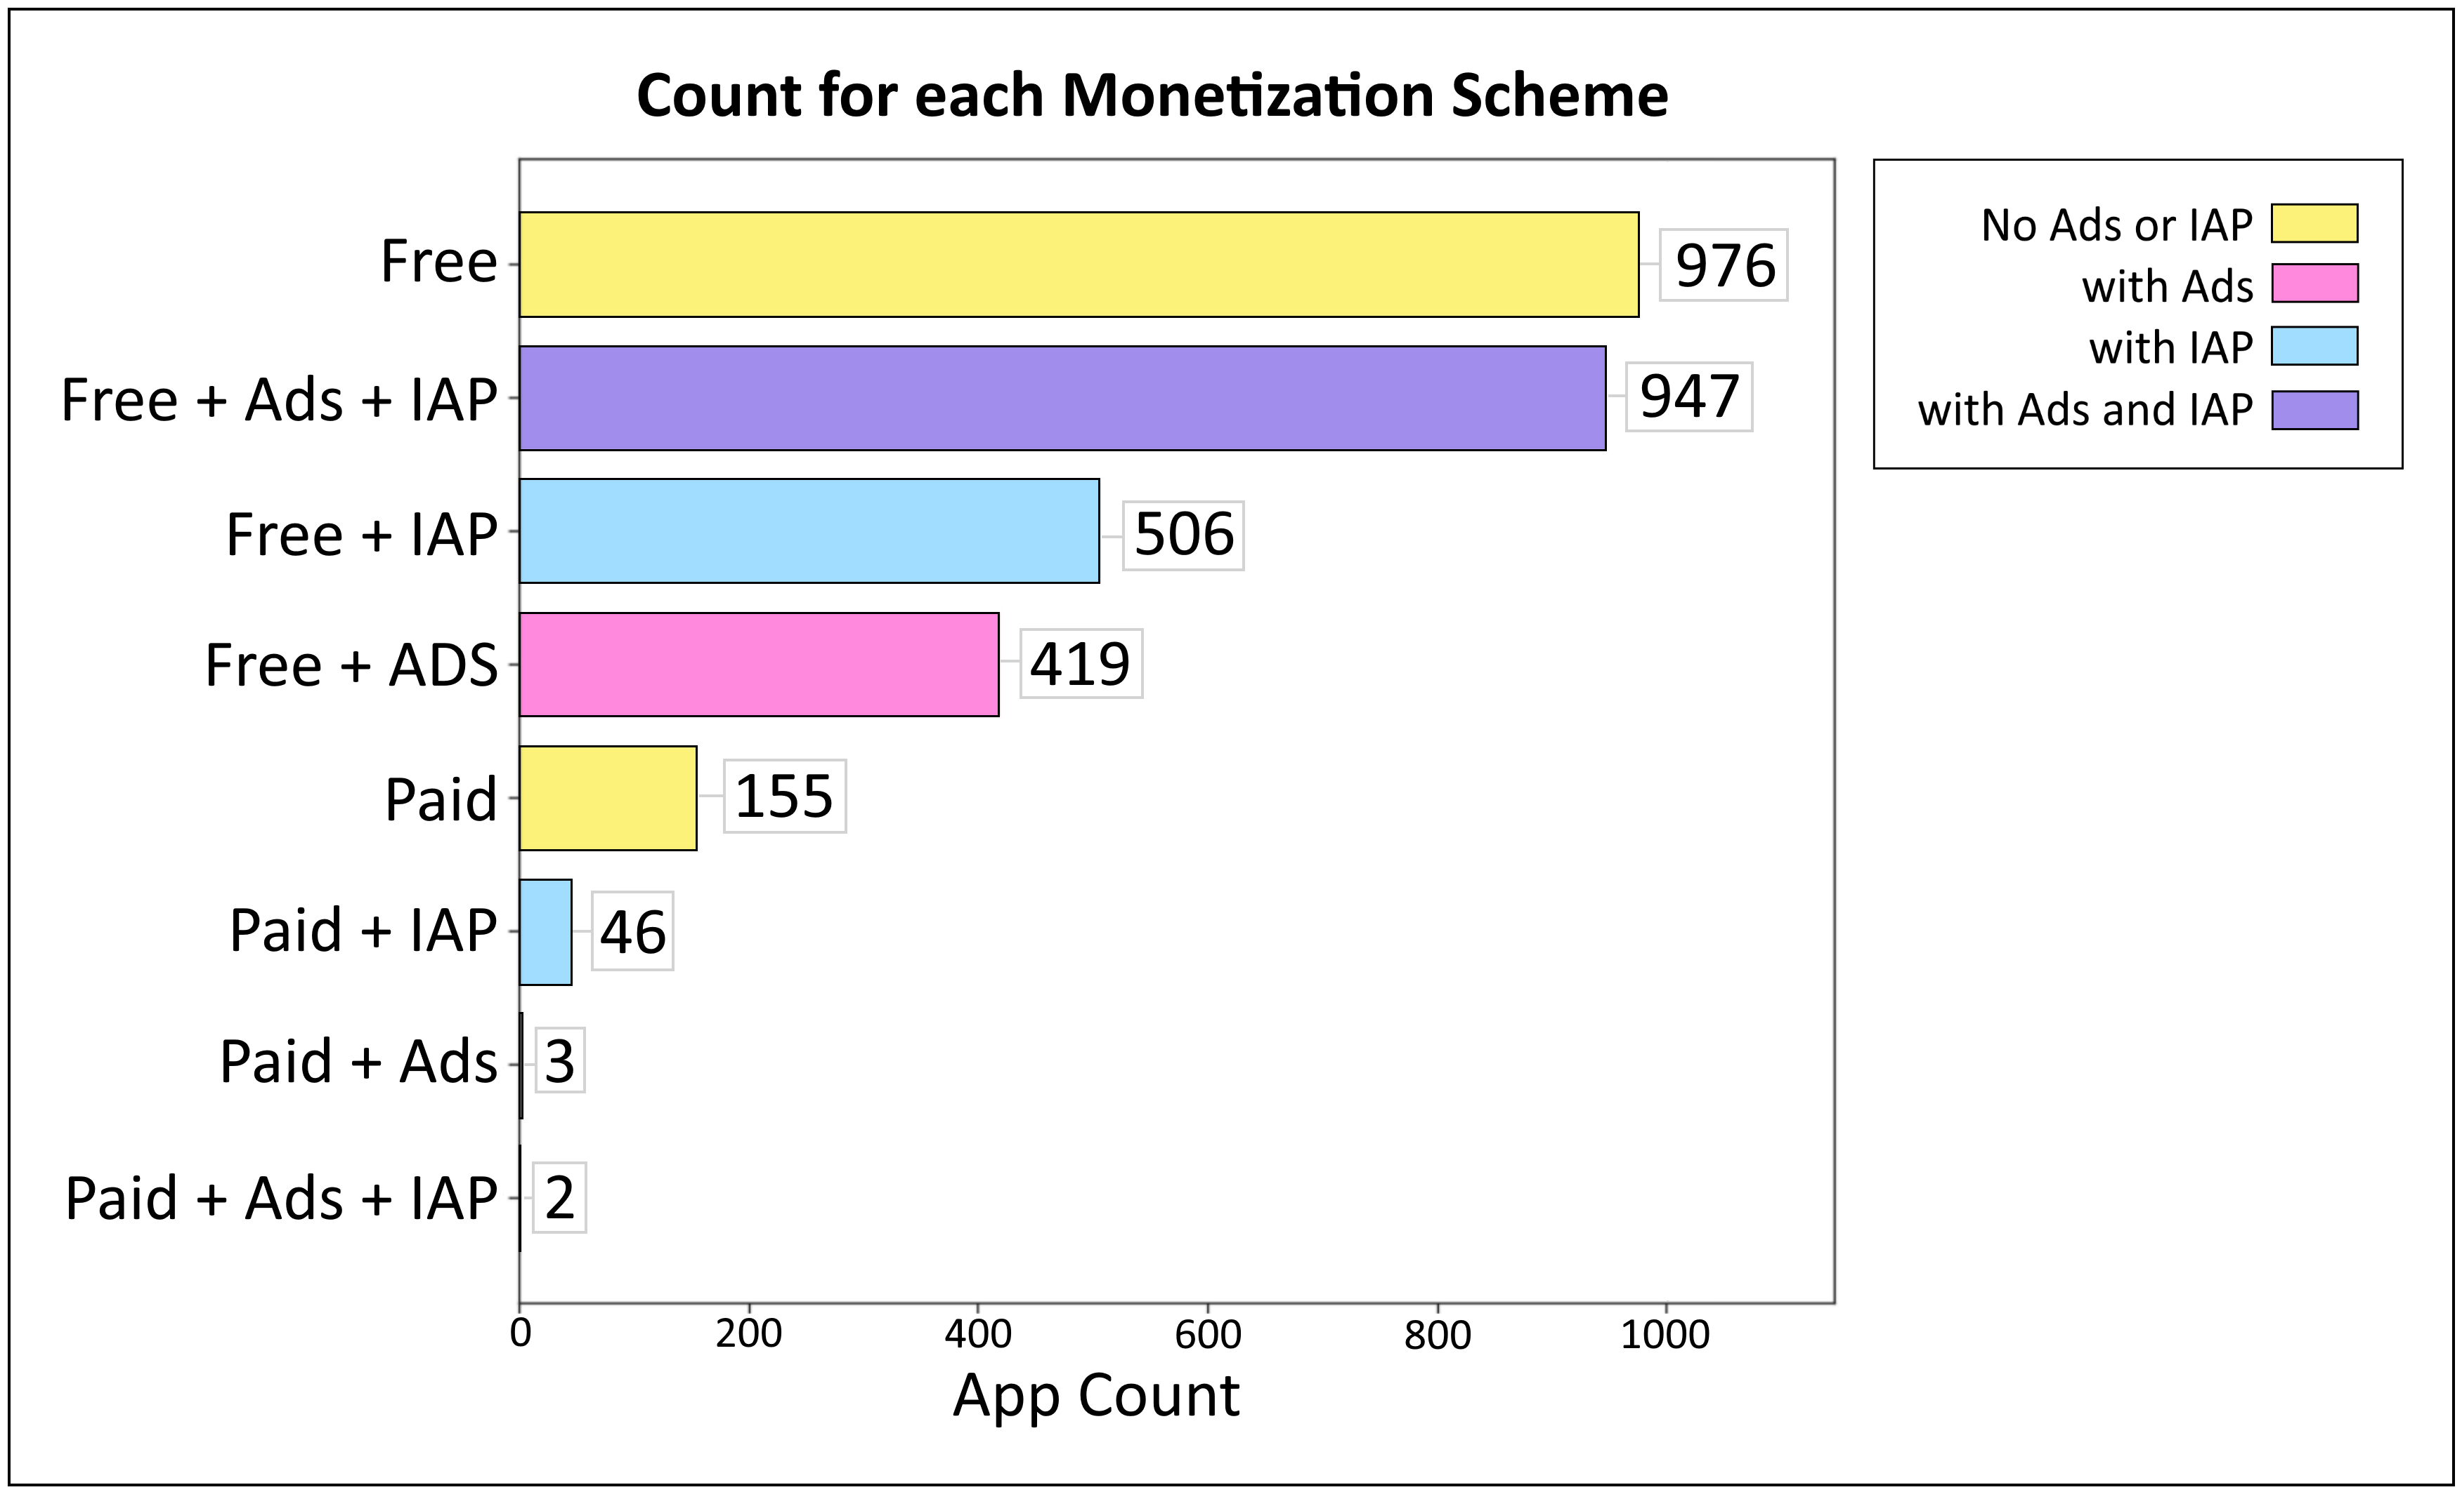
Notes:
Here we have the counts for each type of monetization scheme.
An app can be free or paid, it can contain ads and it can contain in app products IAP which is essentially more things to buy within an app.
I did decide to exclude these two bottom categories, because there wasn't enough apps, and it's clearly not a monetization scheme that's used very often, don't see many apps that are paid with ads in them.

Slide 21
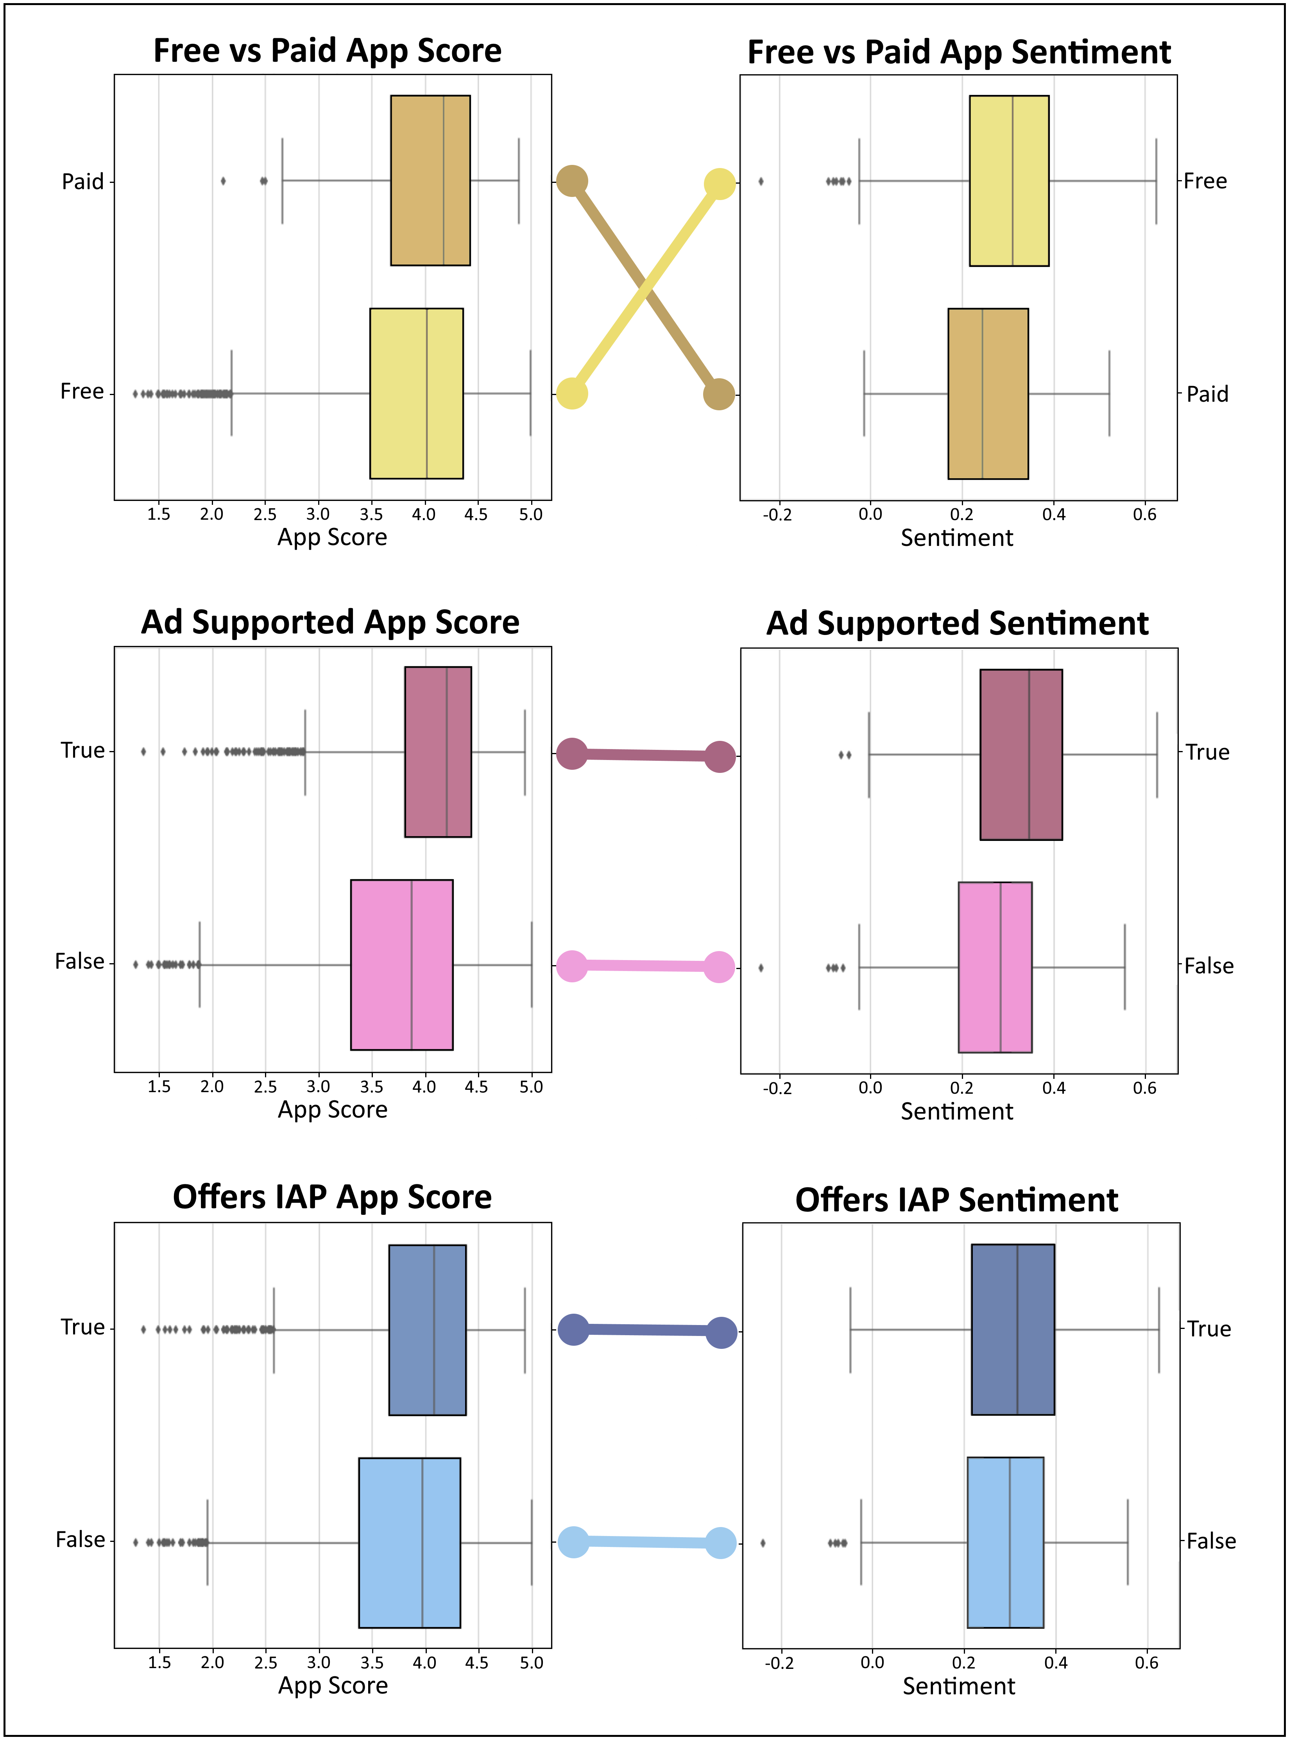
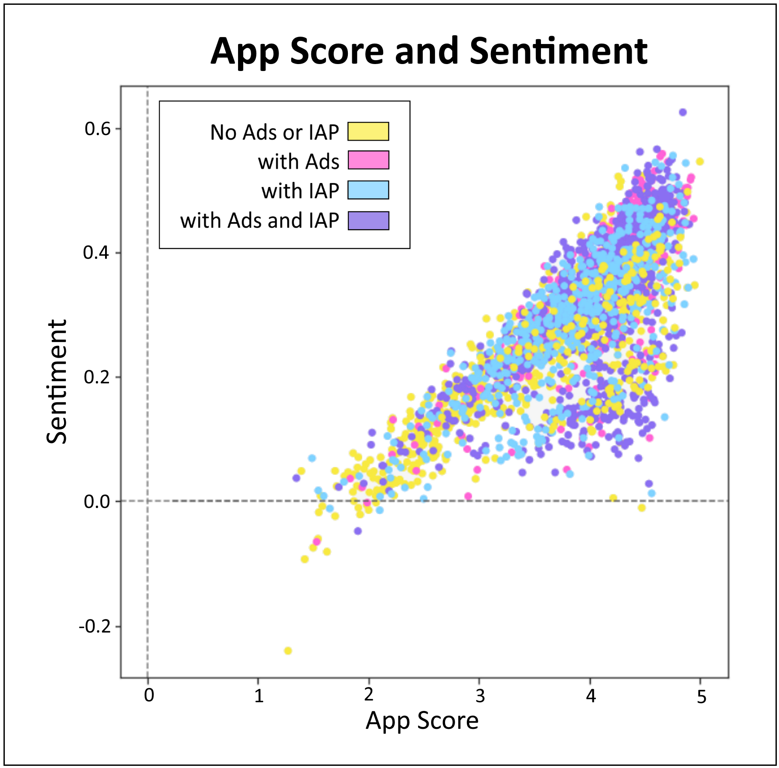
Notes:
Paid apps tend to have a higher score but lower sentiment. This might mean that they are of higher quality but reviewers have higher expectations.
Ad supported apps are higher in both score and sentiment, And the same with apps that support IAP.
This might mean that the apps are of higher quality and are able to take advantage of these forms of monetization without it effecting the ratings.
This is the spread of apps with their monetization scheme in color. Looks to be distributed evenly, but free apps tend to reach lower into the score and sentiment.

Slide 22
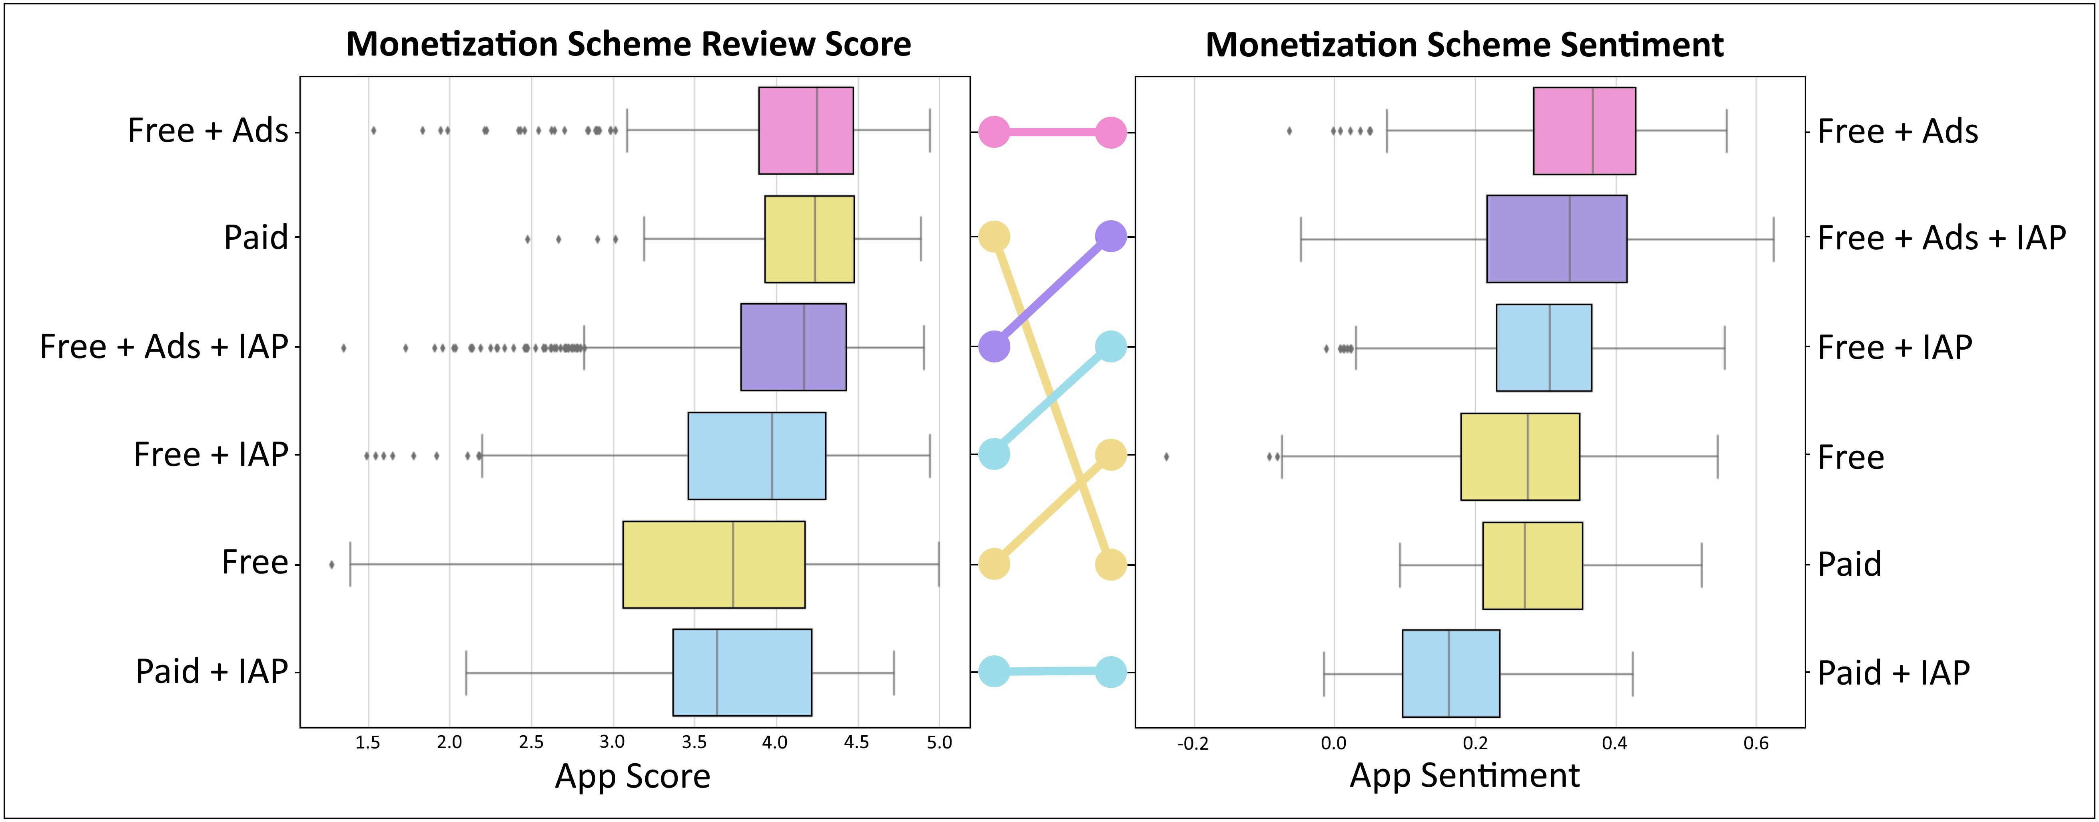
Notes:
Here we can see the ranking of each scheme from their median values. Free with ads being top in both score and sentiment,
whilst paid with Iap being lowest in both score and sentiment.
Regular paid apps slips down the rankings of sentiment relative to its score.
But free with ads is the clear winner here if your looking to maximize score and sentiment.

Slide 23
Summary
Collected more than 2 million reviews spread among 24 app genres.
Used Sentiment analysis to identify positive genres - Maps & Navigation
negative genres - Dating, Games
Discussed the common ways users review apps – review length
common language
Paid apps generally have a higher App Score but lower Sentiment than Free apps
Free apps with Ads have highest App Score and Sentiment
Notes:
Just to summarize.
Collected more than 2 million reviews.
Used sentiment analysis to identify positive and negative genres.
Discussed the common ways people review apps and what they say.
And paid apps generally have a higher score but lower sentiment than free apps. free with ads dominating score and sentiment overall. Thank you for listening

